Slide 1
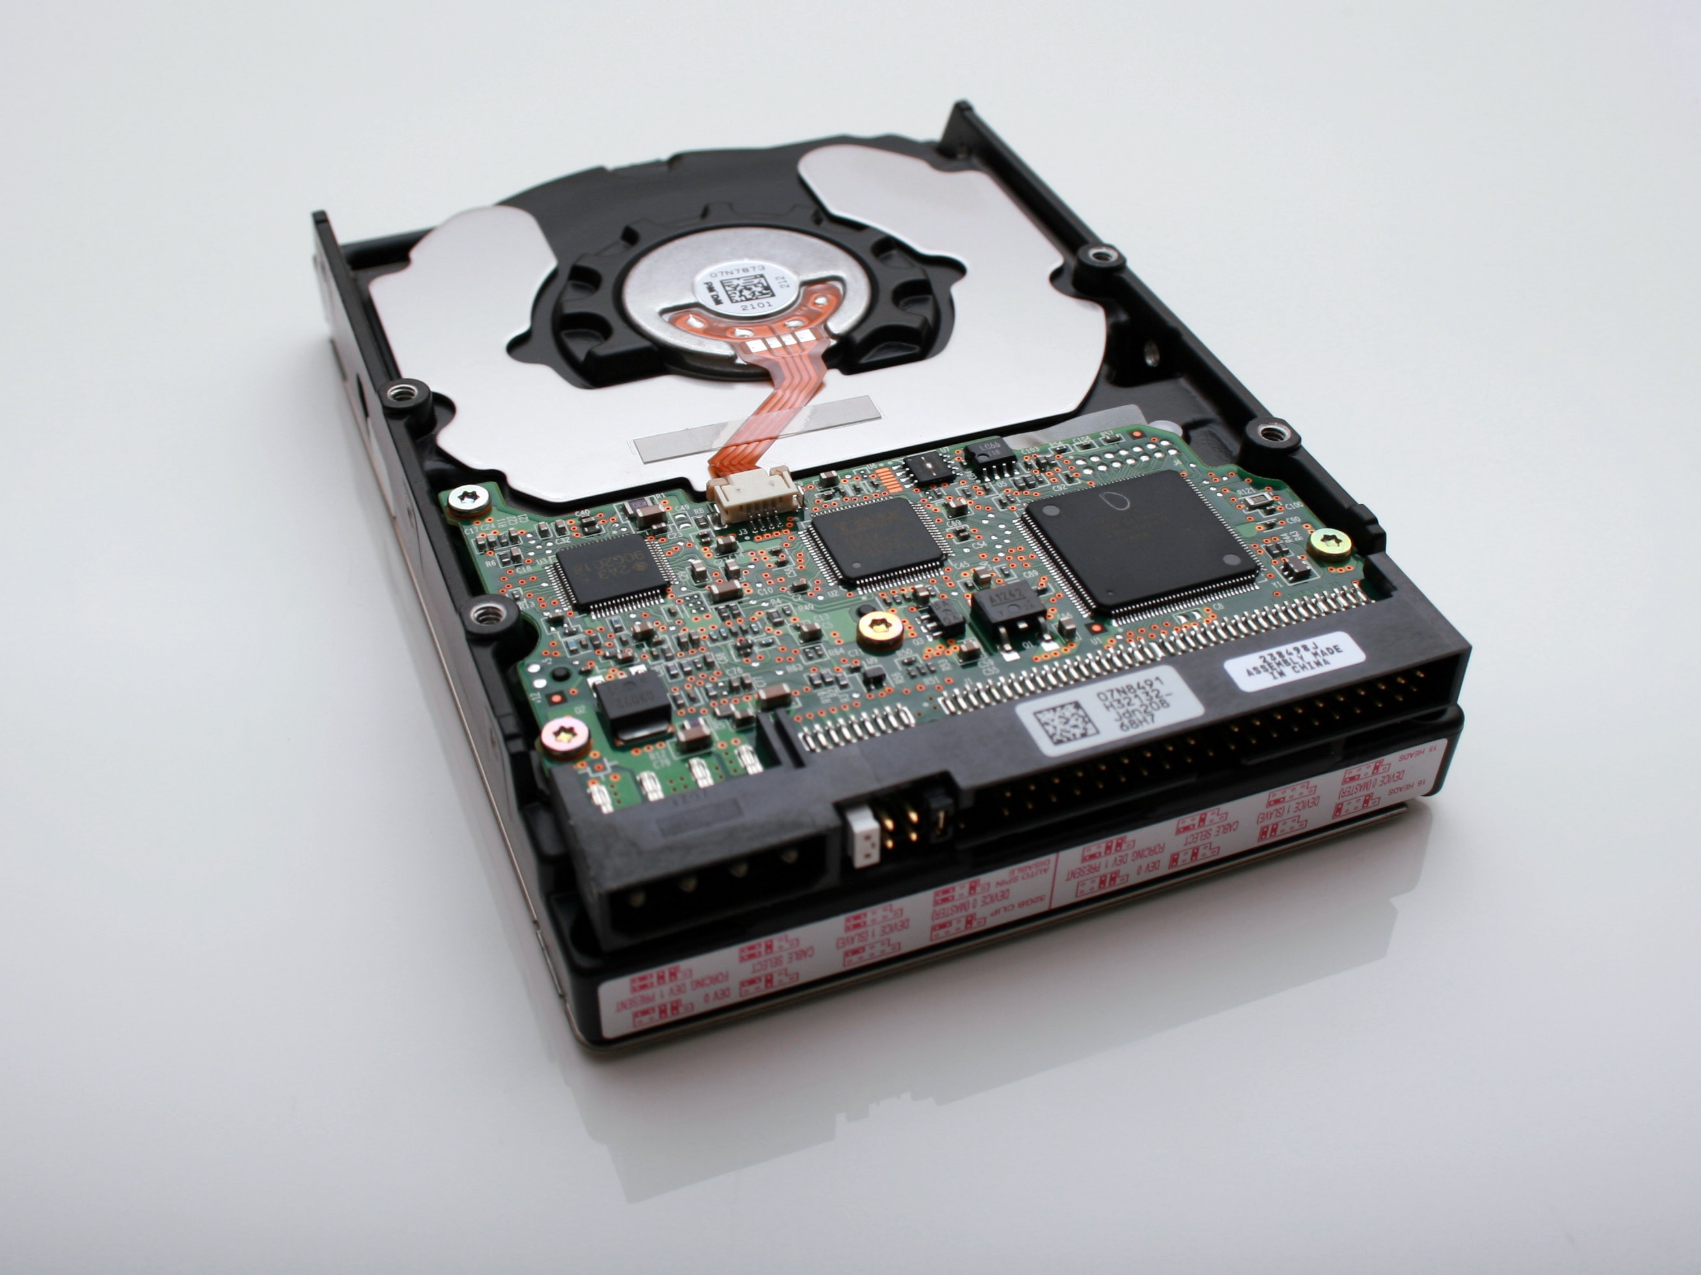
Understanding Kubernetes Storage
Mateusz Dymiński

Slide 2
whoami
Mateusz Dymiński
Software Developer at Nokia
5+ exp with Java
5+ exp with Go
One of the organizer GoWroc - Golang Wroclaw Meetup
Github: github.com/mateuszdyminski
Twitter: @m_dyminski
LinkedIn: linkedin.com/in/mdyminski

Slide 3
Agenda
Kubernetes Storage Entities
Persistent Volume Lifecycle
Stateful Applications
Storage Features
Container Storage Interface
MythBusters
Summary

Slide 4

github.com/mateuszdyminski/storage

Slide 5
Containers are stateless
Cleared on exit
Unless a persistent volume is used.

Slide 6
Database in Pod
apiVersion: apps/v1
kind: Pod
metadata:
name: mysql
spec:
containers:
- image: mysql:5.6
name: mysql
env:
- name: MYSQL_ROOT_PASSWORD
value: password
ports:
- containerPort: 3306
name: mysql
All the data is lost
when container ends

Slide 7

Kubernetes Storage Entities

Slide 8
Pod
Mounts PersistentVolumeClaim into container(s)

Slide 9
PersistentVolumeClaim (PVC)
Application request for storage.
Created by user / devops.
Binds to single PV.
Usable in Pods.

Slide 10
PersistentVolume (PV)
Pointer to physical storage.
Binds to single PVC.
Created by admin ("pre-provisioning").
Created by Kubernetes on demand ("dynamic provisioning").

Slide 11
StorageClass
Collection of PersistentVolumes with the same characteristics.
"Fast", "Cheap", "Replicated", ...
Parameters for dynamic provisioning.
Created by admin. Subject of quota per namespace.

Slide 12
Kubernetes Storage Entities Portability
Portable across Kubernetes clusters.
Pod
PersistentVolumeClaim (PVC)

Slide 13
Kubernetes Storage Entities Portability
Not portable across Kubernetes clusters.
PersistentVolume (PV)
StorageClass
Both contain details about the storage:
Volume plugin.
IP addresses of storage server(s).
Paths.
Usernames / passwords.

Slide 14

Stateful Pod Step by Step

Slide 15
Pod mounts PersistentVolumeClaim into container(s)
apiVersion: apps/v1
kind: Pod
metadata:
name: mysql
spec:
containers:
- image: mysql:5.6
name: mysql
env:
- name: MYSQL_ROOT_PASSWORD
value: password
volumeMounts:
- name: mysql-persistent-storage
mountPath: /var/lib/mysql
volumes:
- name: mysql-persistent-storage
persistentVolumeClaim:
claimName: mysql-pv-claim

Slide 16
PersistentVolumeClaim = request for storage
kind: PersistentVolumeClaim
apiVersion: v1
metadata:
name: mysql-pv-claim
spec:
resources:
requests:
storage: 1Gi
accessModes:
- ReadWriteOnce
"Give me 1 GiB of storage."
"That is mountable to single pod as read/write."
"And I don't really care about the rest."

Slide 17
PersistentVolumeClaim
$ kubectl create -f pvc.yaml
persistentvolumeclaim/mysql-pv-claim created
$ kubectl get pvc
NAME STATUS VOLUME CAPACITY ACCESS MODES STORAGECLASS AGE
my-mysql-claim Bound pvc-6428 1Gi RWO standard 1m

Slide 18
PersistentVolume
kind: PersistentVolume
apiVersion: v1
metadata:
name: task-pv-volume
labels:
type: local
spec:
storageClassName: cheap
capacity:
storage: 10Gi
accessModes:
- ReadWriteOnce
persistentVolumeReclaimPolicy: Retain
hostPath:
path: "/mnt/data"
StorageClass where this
volume belongs.

Slide 19
PersistentVolume
kind: PersistentVolume
apiVersion: v1
metadata:
name: task-pv-volume
labels:
type: local
spec:
storageClassName: cheap
capacity:
storage: 10Gi
accessModes:
- ReadWriteOnce
persistentVolumeReclaimPolicy: Retain
hostPath:
path: "/mnt/data"
Size of the Volume

Slide 20
PersistentVolume
kind: PersistentVolume
apiVersion: v1
metadata:
name: task-pv-volume
labels:
type: local
spec:
storageClassName: cheap
capacity:
storage: 10Gi
accessModes:
- ReadWriteOnce
persistentVolumeReclaimPolicy: Retain
hostPath:
path: "/mnt/data"
Access modes that the
volume supports

Slide 21
PersistentVolume
kind: PersistentVolume
apiVersion: v1
metadata:
name: task-pv-volume
labels:
type: local
spec:
storageClassName: cheap
capacity:
storage: 10Gi
accessModes:
- ReadWriteOnce
persistentVolumeReclaimPolicy: Retain
hostPath:
path: "/mnt/data"
What to do when the volume is
not needed any longer. Options:
Recycle (deprecated),
Retain,
Delete

Slide 22
PersistentVolume
kind: PersistentVolume
apiVersion: v1
metadata:
name: task-pv-volume
labels:
type: local
spec:
storageClassName: cheap
capacity:
storage: 10Gi
accessModes:
- ReadWriteOnce
persistentVolumeReclaimPolicy: Retain
hostPath:
path: "/mnt/data"
Pointer to Storage
AWS EBS, Azure DD, Ceph FS & RBD, CSI, FC, Flex, GCE PD, Gluster, iSCSI, NFS, OpenStack Cinder,
Photon, Quobyte, StorageOS, vSphere

Slide 23
StorageClass
kind: StorageClass
apiVersion: storage.k8s.io/v1
metadata:
name: slow
provisioner: kubernetes.io/gce-pd
annotations:
storageclass.kubernetes.io/is-default-class: "true"
parameters:
type: pd-standard
zone: us-east1-d
Collection of PersistentVolumes with the same characteristics.
Usually admin territory.
Global, not namespaced.

Slide 24
StorageClass
kind: StorageClass
apiVersion: storage.k8s.io/v1
metadata:
name: slow
provisioner: kubernetes.io/gce-pd
annotations:
storageclass.kubernetes.io/is-default-class: "true"
parameters:
type: pd-standard
zone: us-east1-d
Who dynamically provisions volumes.
Name of hardcoded volume plugin.
Name of external provisioner.
Name of CSI driver.

Slide 25
StorageClass
kind: StorageClass
apiVersion: storage.k8s.io/v1
metadata:
name: slow
provisioner: kubernetes.io/gce-pd
annotations:
storageclass.kubernetes.io/is-default-class: "true"
parameters:
type: pd-standard
zone: us-east1-d
Parameters for dynamic provisioning.
Depend on the provisioner.

Slide 26
StorageClass
kind: StorageClass
apiVersion: storage.k8s.io/v1
metadata:
name: slow
provisioner: kubernetes.io/gce-pd
annotations:
storageclass.kubernetes.io/is-default-class: "true"
parameters:
type: pd-standard
zone: us-east1-d
One StorageClass in the cluster can be default.
PVC without any StorageClass gets the default one.

Slide 27
PersistentVolume lifecycle

Slide 28
PersistentVolume – Dynamic Provisioning
Admin
Storage
Storage Class
Persistent
Volume
User
PersistentVolumeClaim

Slide 29
PersistentVolume – Manual Provisioning
Admin
Storage
Storage Class
Persistent
Volume
User
PersistentVolumeClaim

Slide 30
PersistentVolume – Release
Admin
Storage
Storage Class
Persistent
Volume
User
PersistentVolumeClaim

Slide 31
PersistentVolume – Release
PVC is deleted: persistentVolumeReclaimPolicy is executed:
Recycle (deprecated):
All data from the volume are removed ("rm -rf *").
PV is Available for new PVCs.
Delete:
Volume is deleted in the storage backend.
PV is deleted.
Usually for dynamically-provisioned volumes
Retain:
PV is kept Released.
No PVC can bind to it.
Admin should manually prune Released volumes. In all cases, user can't access the data!

Slide 32
Stateful applications

Slide 33
Deployment
Runs X replicas of a single Pod template.
When a pod is deleted, Deployment automatically creates a new one.
Scalable up & down.
All pods share the same PVC!

Slide 34
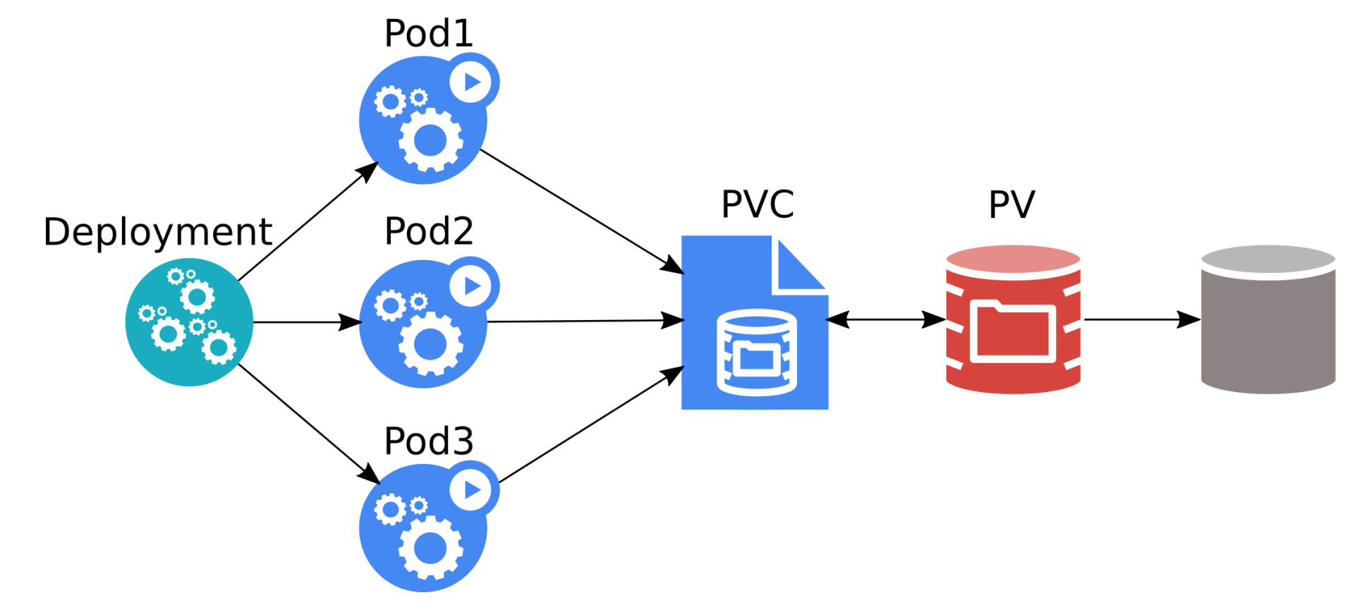
Deployment
Source: Kubernetes Storage 101 - Jan Šafránek, Red Hat & David Zhu, Google

Slide 35
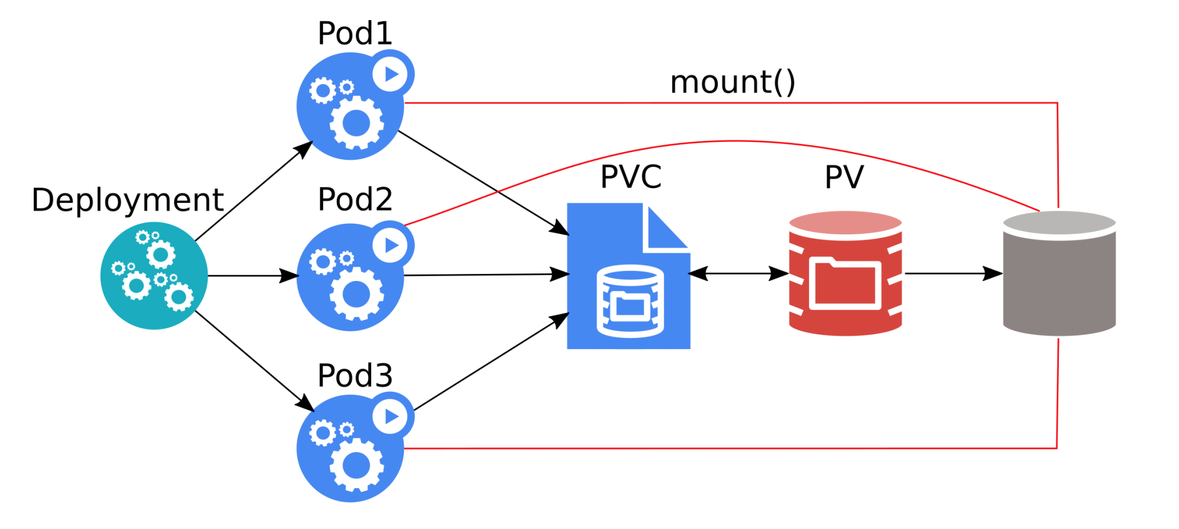
Deployment
All three pods can overwrite data of each other!
Most applications crash / refuse to work.
Source: Kubernetes Storage 101 - Jan Šafránek, Red Hat & David Zhu, Google

Slide 36
StatefulSet
Runs X replicas of a single Pod template.
Each pod gets its own PVC(s) from a PVC template.
When a pod is deleted, StatefulSet automatically creates a new one.
Each pod has a stable identity.
Scalable up & down.

Slide 37
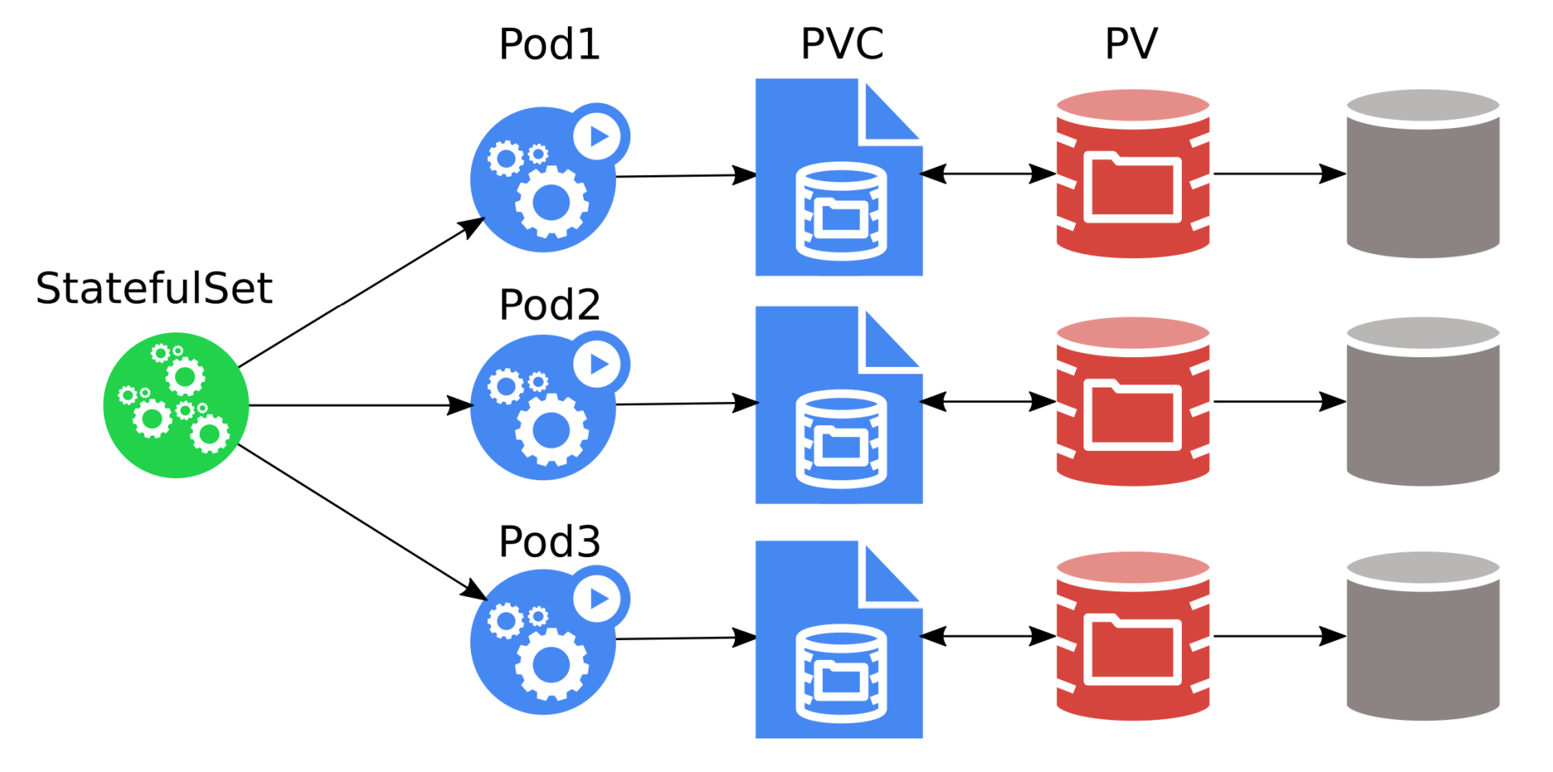
StatefulSet
The pods must be aware of the other StatefulSet members!
Source: Kubernetes Storage 101 - Jan Šafránek, Red Hat & David Zhu, Google

Slide 38
Storage features

Slide 39
LocalVolumes
Unused local disks can be used as PVs.
Extra speed.
Lower reliability.
No pod scheduling flexibility.

Slide 40
Resize
Only expansion is supported.
Offline.
Online (alpha).

Slide 41
Snapshots
Alpha.
Part of CSI.
Can take a snapshot of PVC.
PVC can be provisioned from a snapshot.
More: https://kubernetes.io/blog/2018/10/09/introducing-volume-snapshot-alpha-for-kubernetes/

Slide 42


Slide 43
CSI = Container Storage Interface
Container Storage Interface (CSI) is an initiative to unify the storage interface of Container Orchestrator Systems (COs) like Kubernetes, Mesos, Docker swarm, cloud foundry, etc.
Implementing a single CSI for a storage vendor is guaranteed to work with all COs.

Slide 44
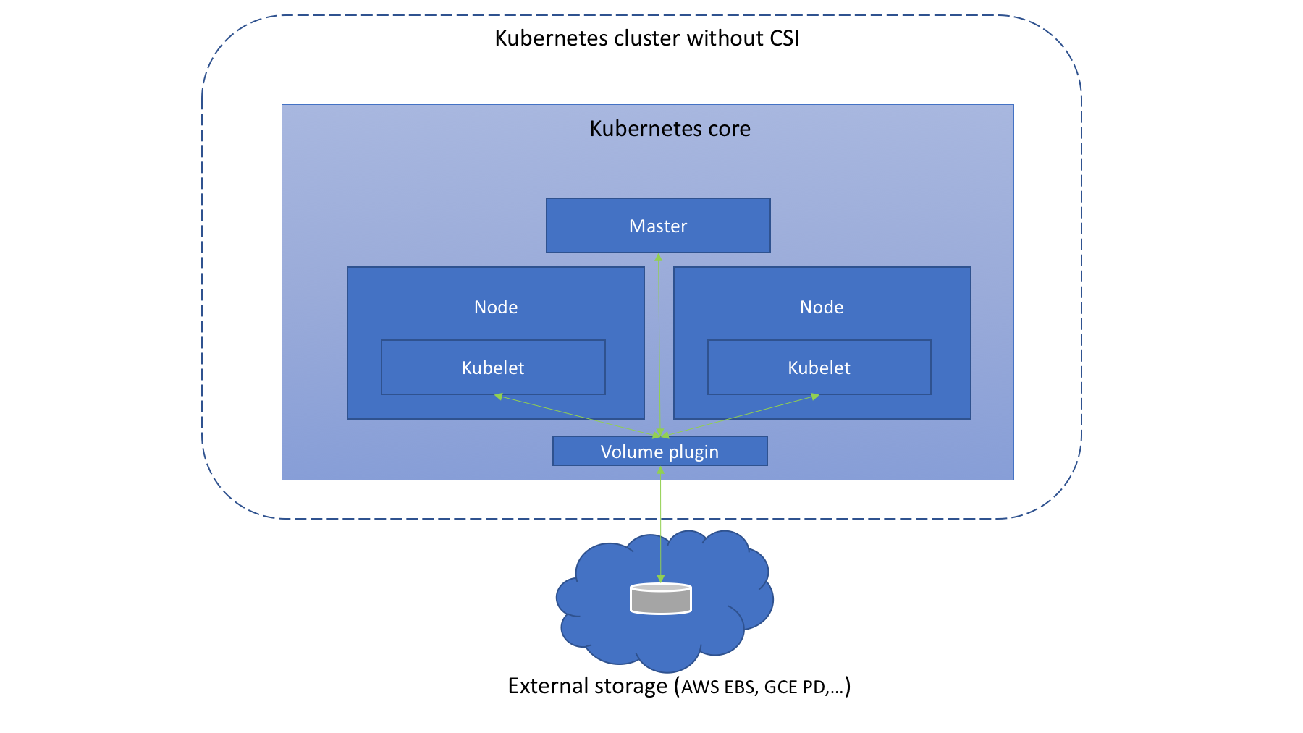
Before CSI
Source: https://medium.com/google-cloud/understanding-the-container-storage-interface-csi-ddbeb966a3b

Slide 45
Before CSI - problems
Volume plugin development coupled and dependent on Kubernetes releases.
Kubernetes developers/community are responsible for testing and maintaining all volume plugins.
Bugs in volume plugins can crash Kubernetes core components
Volume plugins get full privileges of kubernetes components (kubelet and kube-controller-manager).
Plugin developers are forced to make plugin source code available – open-source

Slide 46
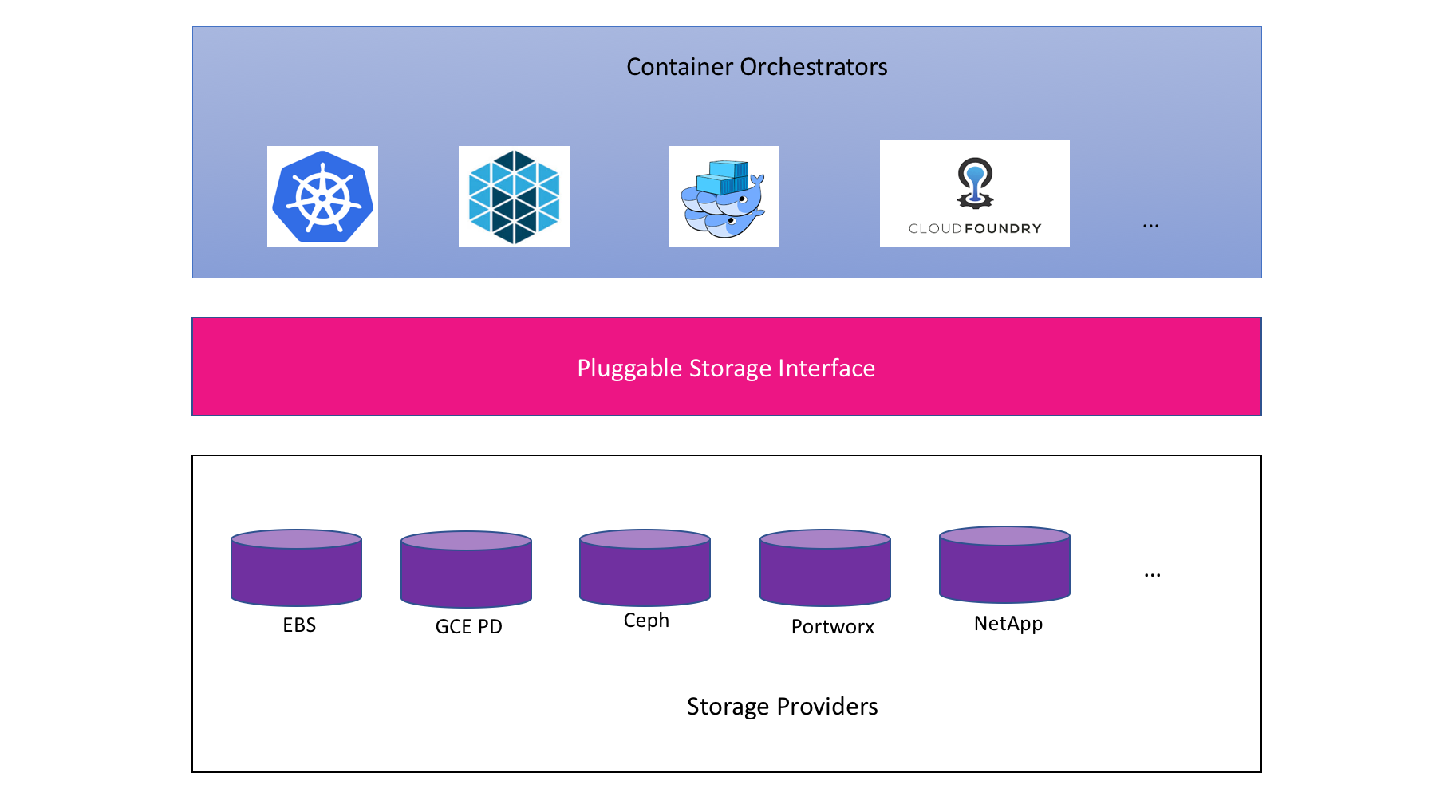
CSI concept
Source: CloudNativeCon EU 2018 CSI Jie Yu

Slide 47
CSI exmaple
kind: StorageClass
apiVersion: storage.k8s.io/v1
metadata:
name: fast-storage
provisioner: csi-driver.example.com
parameters:
type: pd-ssd
csi.storage.k8s.io/provisioner-secret-name: mysecret
csi.storage.k8s.io/provisioner-secret-namespace: mynamespace

Slide 48
CSI – materials
Webpage - https://kubernetes-csi.github.io/
Specification - https://github.com/container-storage-interface/spec
Great talks:
Container Storage Interface: Present and Future - Jie Yu
Container Storage Interface for Kubernetes

Slide 49


Slide 50
Myth 1: Applications in containers must be stateless

Slide 51
Myth 2: Writes done by container apps are slow
https://www.youtube.com/watch?v=4V-4yPSfN3U
Benchmarking Cloud Native Storage - Josh Berkus, Red Hat – KubeCon Europe 2019
hostPath and Local Volume as fast as Local Volume
Perf depends on cloud provider

Slide 52
Myth 3: storing data on k8s requires distributed storage

Slide 53
Myth 4: Never run DB on k8s

Slide 54

Summary

Slide 55
Takeaways

Slide 56

Q&A

